Slide 1

SCHOOL OF ENGINEERING AND RESEARCH
ENGLISH PRESENTATION:
ONLINE GAMING ADDICTION
NAME – SOUMAYE BARNWAL
BCA (CTIS) 4TH SEM
130410424042
GUIDED BY:
MRS.ANAMIKA MAHAPATRA

Slide 2
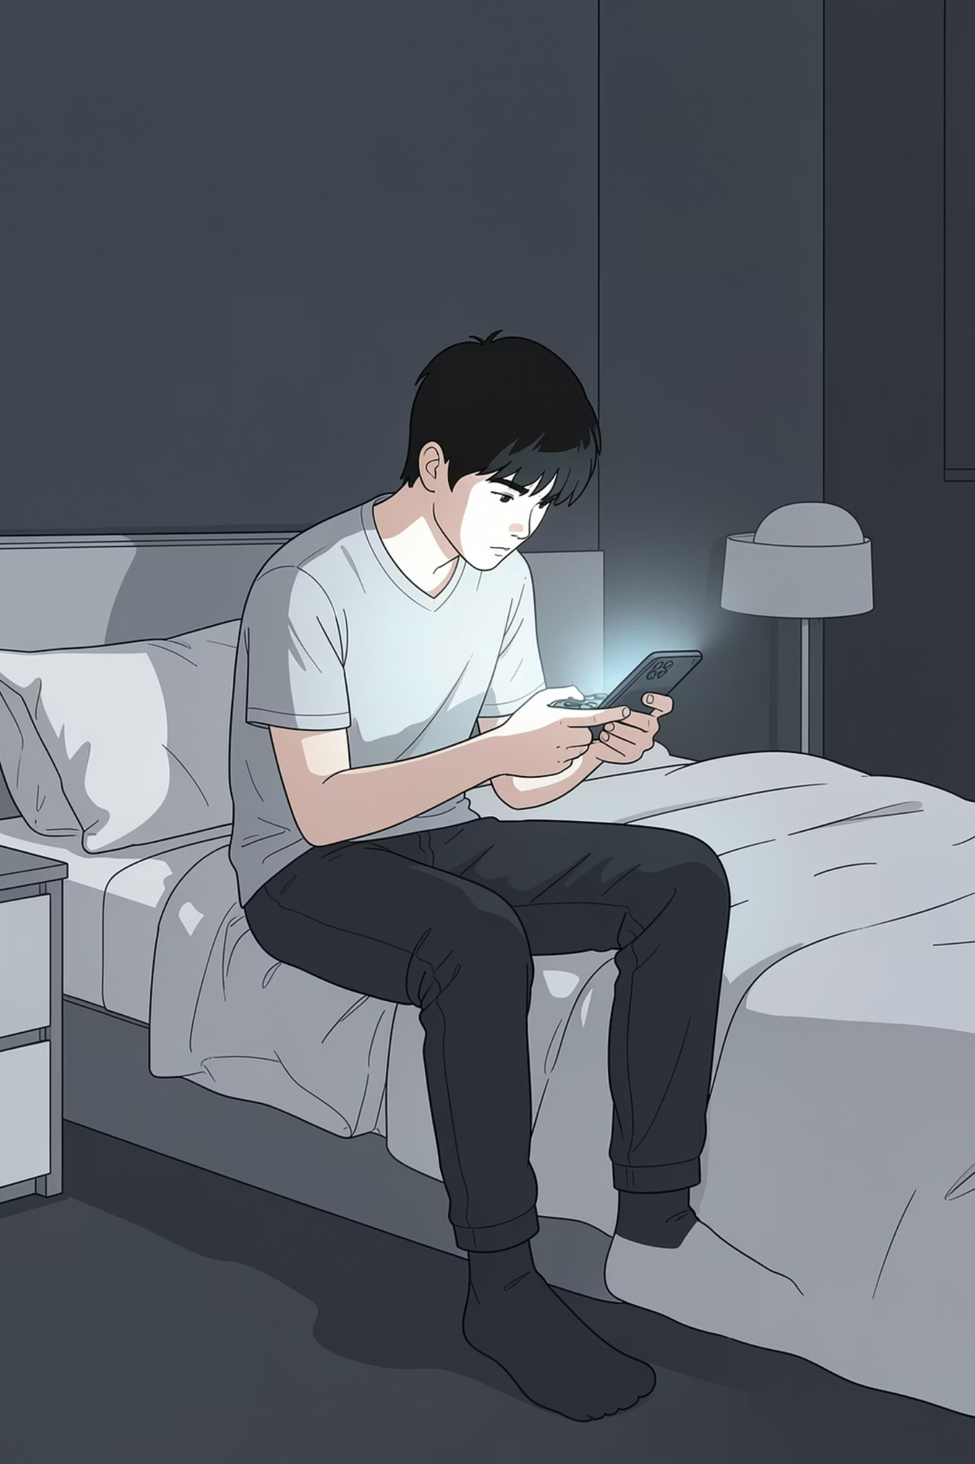
Online Gaming & Addiction
Online gaming — playing video games via the internet — has grown rapidly thanks to smartphones and high-speed connectivity. Popular across all ages, it is especially prevalent among young people. But when gaming becomes compulsive, the consequences can be serious.
AWARENESS GUIDE
FOR PARENTS, EDUCATORS & YOUNG ADULTS

Slide 3
What is Online Gaming Addiction?
Online gaming addiction is a condition where a person becomes excessively involved in
playing online video games to the point that it starts negatively affecting their daily life.
Key Features:
Spending many hours gaming every day
Feeling restless, irritated, or upset when not playing
Ignoring responsibilities like school, work, or family
Losing interest in other activities or hobbies

Slide 4
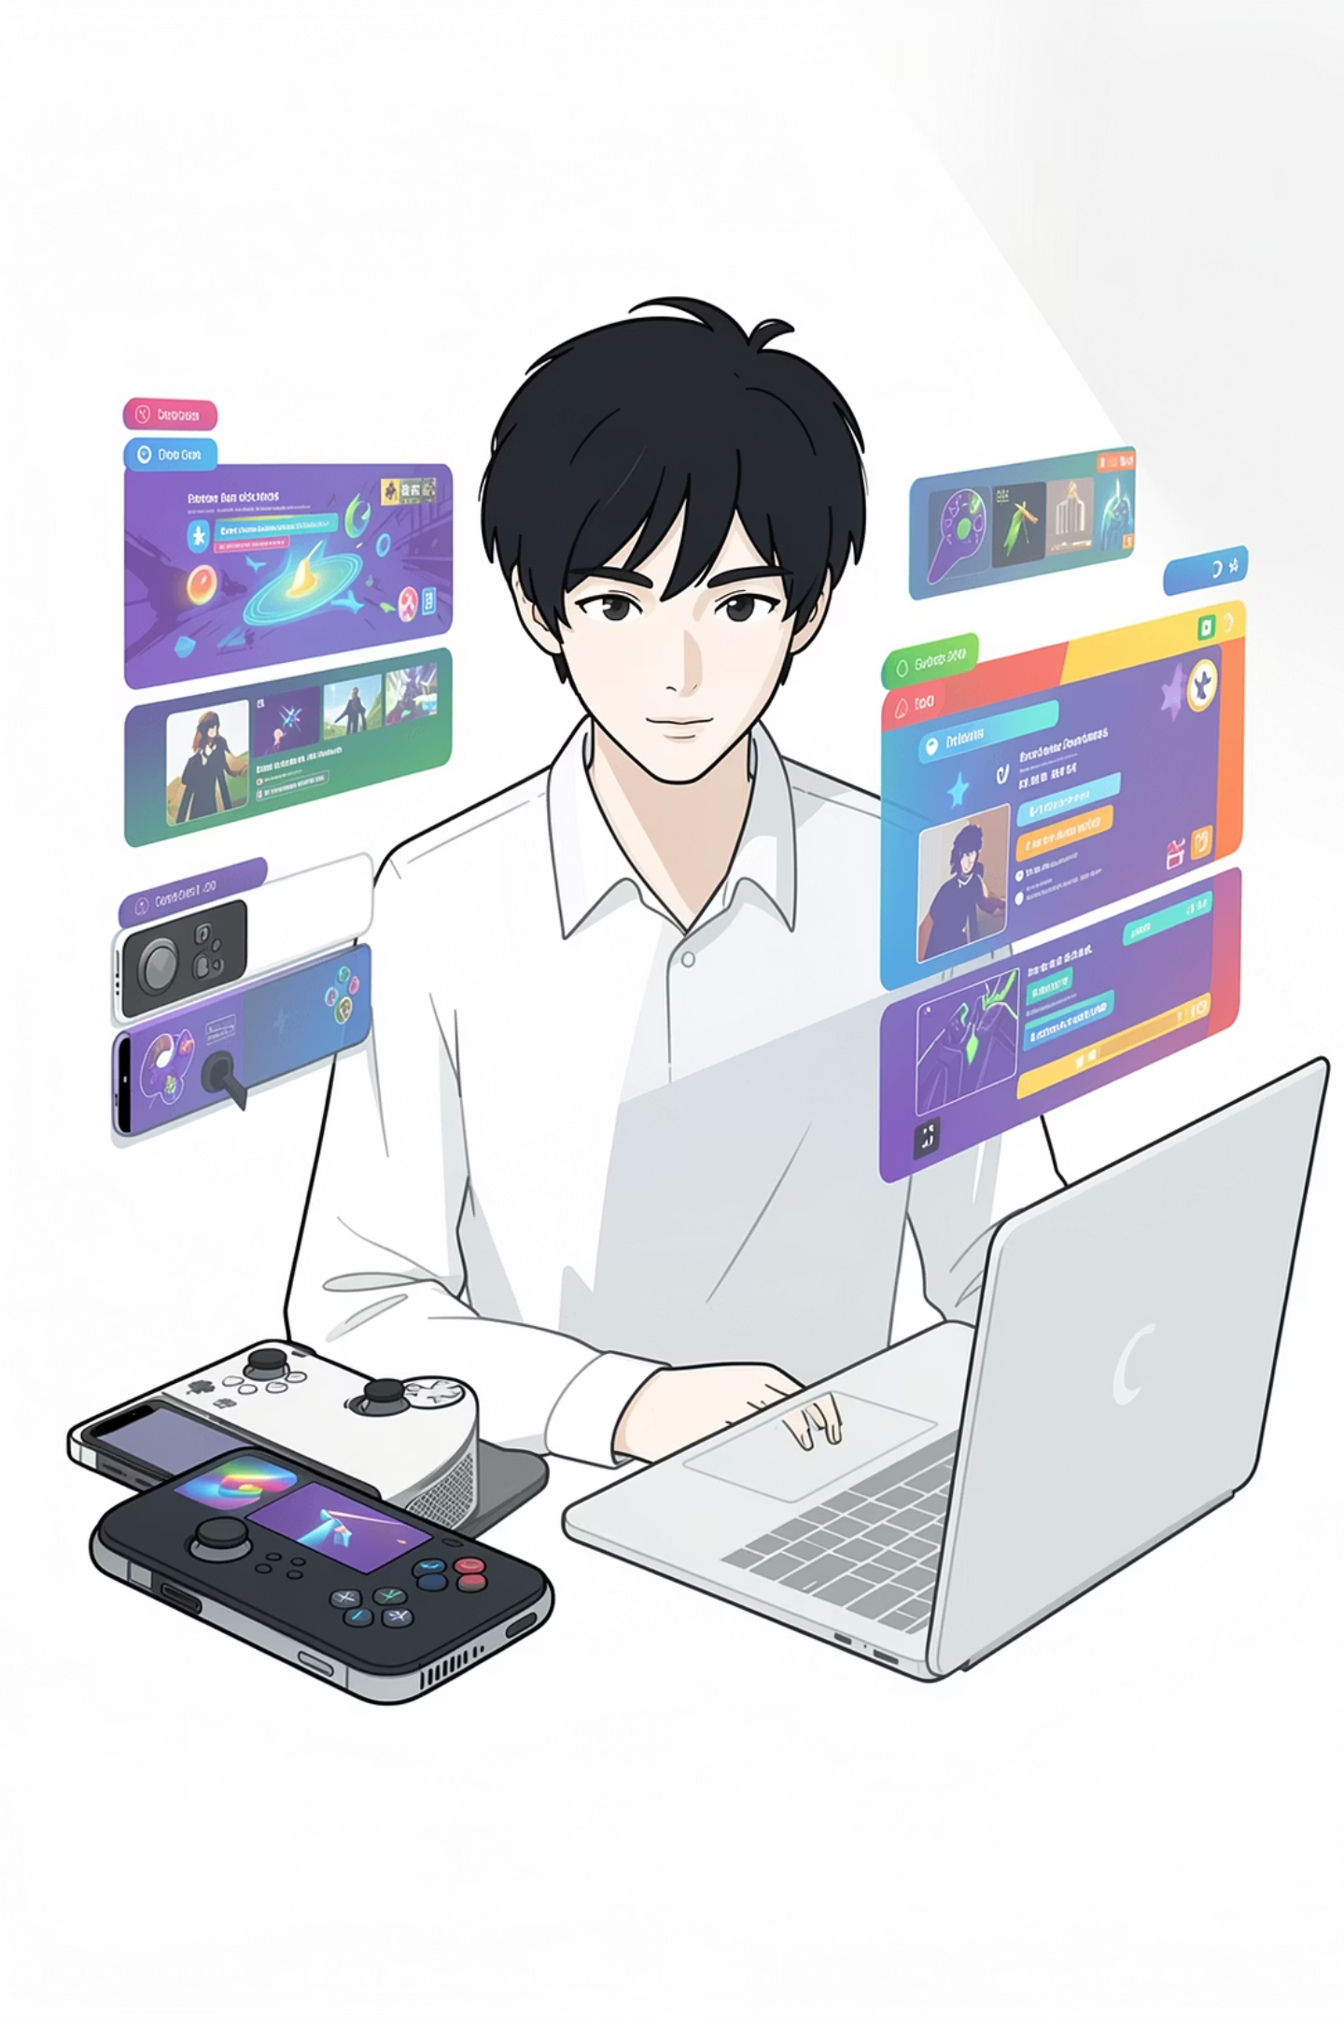
What Drives Gaming Addiction?
Easy Access
Games are available 24/7 on mobile, PC, and
consoles—making it easy to play anytime, anywhere.
Social Connection
Multiplayer games offer community, competition, and
a sense of belonging that can feel hard to find offline.
Reward Systems
Levels, points, and achievements the urge to keep playing.

Slide 5
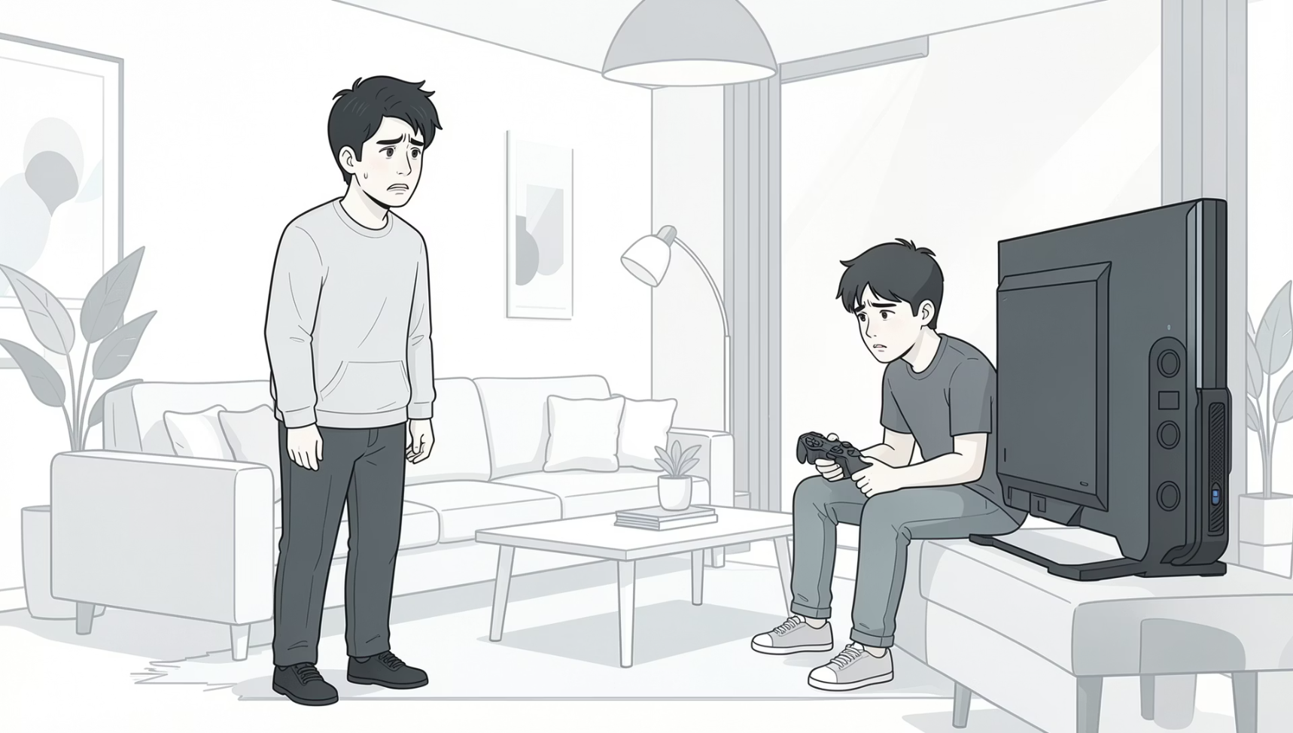
Signs & Symptoms
The key signs and symptoms of online gaming addiction which may indicate a developing
problem:
Excessive screen time
Spending hours gaming, often losing track of time entirely.
Neglecting responsibilities
Studies, work, or household tasks are consistently deprioritized.
Sleep disruption
Staying up late to game, leading to chronic fatigue.
Irritability when offline
Restlessness or anger when unable to access games.

Slide 6

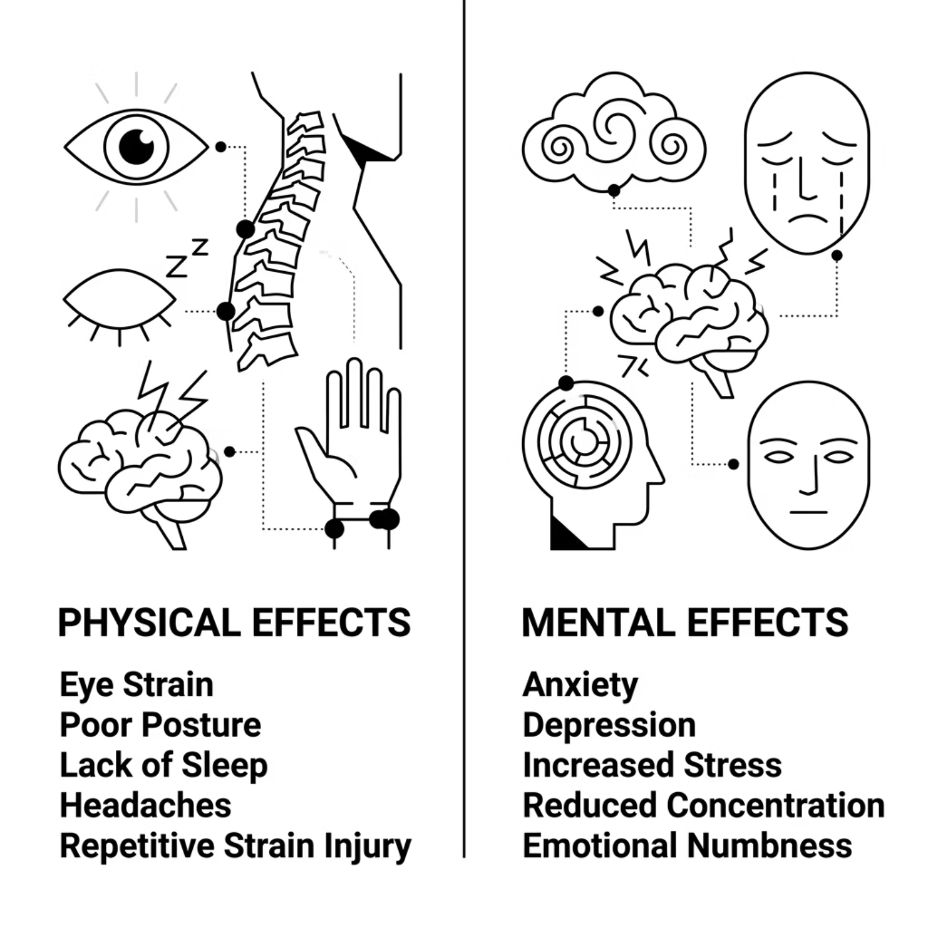
Effects on Health
Physical Effects
Eye strain — Long screen time can cause
tired eyes, dryness, blurred vision, and headaches.
Poor posture — Sitting for long periods in same
positions can lead to back, neck, and shoulder pain
Mental Effects
Anxiety & depression — Excessive gaming can
increase feelings of stress, sadness, and worry.
Reduced concentration —Difficulty focusing on
studies or daily tasks due to constant thoughts
about gaming.

Slide 7
Conclusion on Online Gaming Addiction:
Online gaming is a popular and enjoyable activity that can offer relaxation, entertainment, and even skill development when used in moderation. However, excessive gaming can turn into addiction, leading to serious negative effects on physical health, mental well-being, academic or work performance, and social relationships.
Gaming is beneficial when controlled, but harmful when it becomes excessive—balance is the key.

